Slide 1
The Reinvention of Philanthropic Charities
Scottish Third Sector Research Conference 2010
Presentation by Marion Lacey,
Rock Solid Social Research Ltd.

Slide 2
Overview of presentation
Myth and reality
Public service charities in UK
Comparison with the US
Transforming enterprises

Slide 3
Myth 1
Distinctiveness of social enterprises
soÂ·cial enÂ·terÂ·prise (n.) -
An organization or venture that achieves its primary social or environmental mission using business methods.
The Coalition Charter: …Scotland’s social enterprises are an increasingly valuable part of the fabric of Scottish society. Social enterprises come in all shapes and sizes: from social firms, credit unions, and housing associations, to community and worker co-ops, development trusts and community interest companies.
“Social enterprises are distinct from other voluntary organisations in that trading forms a significant part of their activities and a significant source of income (typically 50% or more).”
EKOS Ltd, 2008 ‘Scoping Study: Support for Social Enterprise Start-u

Slide 4
Myth 2
A contracting public sector
“The Scottish Government wants to create the right operating conditions in which an enterprising third sector can play a full role in the development, design and delivery of policy and services in Scotland, putting the people of Scotland at the heart of their plans. We want to support a country in which an enterprising third sector is encouraged, valued and is given the opportunities it needs to prove its value and deliver more.”
JOHN SWINNEY, Cabinet Secretary for Finance and Sustainable Growth (ENTERPRISING THIRD SECTOR ACTION PLAN 2008-2011)

Slide 5
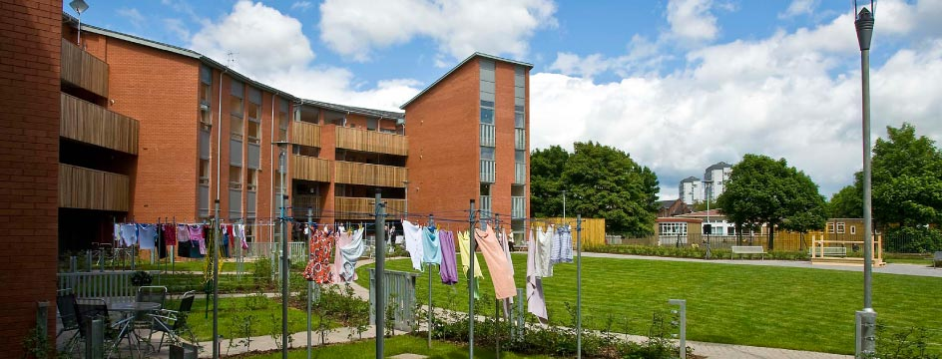
Myth 3
Distinctiveness of sectors

Slide 6
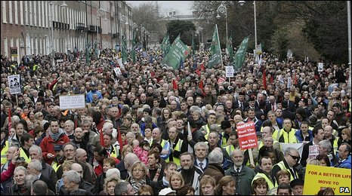
Public Sector Employees

Slide 7
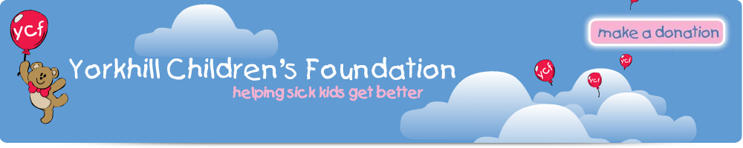

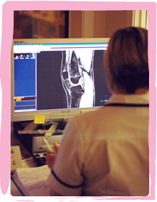
Health Service Charities

Slide 8
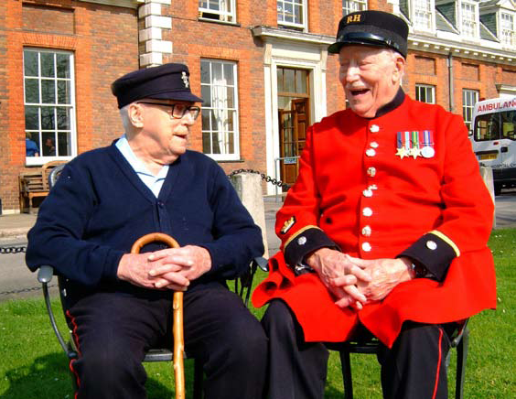
Armed Forces Charities

Slide 9
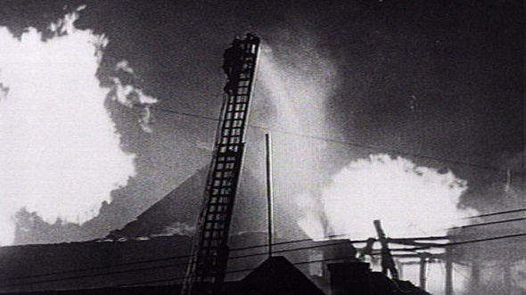
Fire Service Charities
Cheapside Street, March 28th 1960

Slide 10
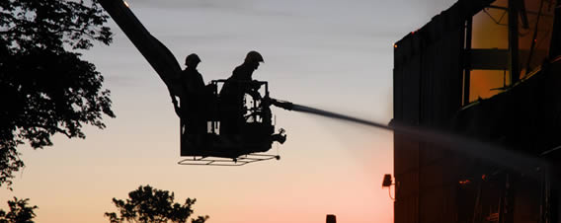
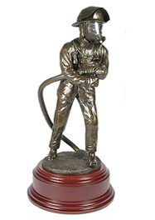
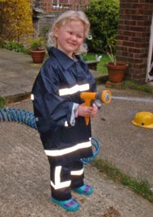
The Fire Fighters Charity

Slide 11

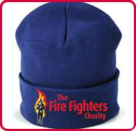
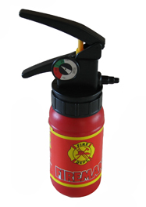

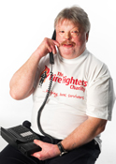
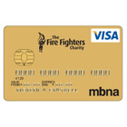
Trading on their reputation
Jubilee Centre, Cumbria

Slide 12


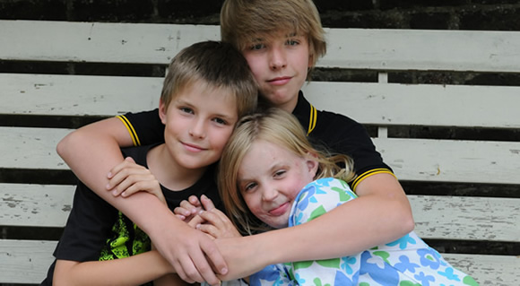
The Children’s Burns Trust
Family Weekend
for Families of Burn-Injured Children
Children’s Burns Trust in conjunction with The Fire Fighters’ Charity and in partnership with
Royal Manchester Children’s Hospital Regional Burns Service, Manchester
Pinderfields Hospital Regional Burns Centre, Wakefield
Royal Victoria Infirmary, Newcastle upon Tyne

Slide 13
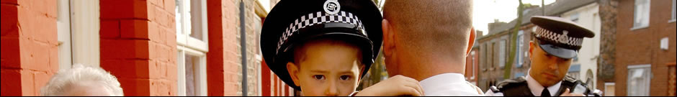
Child Victims of Crime
In March 1993 a terrorist bomb explosion in Warrington, Cheshire killed two boys and injured scores more local people.
As so often in these circumstances, the public reached out in the only way they could. They sent money. Two police officers collected these donations and by organising various fundraising events were eventually able to send 34 child victims of crime to Disney World, Florida.
In 1994 children from Warrington were joined by other young people from Belfast whose lives had also been blighted by terrorism.

Slide 14
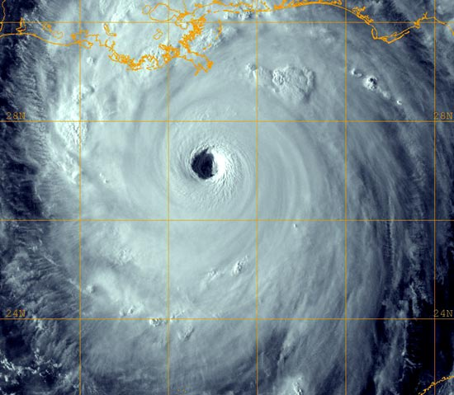
US Public sector charities
Hurricane Katrina Category 5
August 28th 2005

Slide 15

The New Orleans Police & Justice Foundation (NOPJF)
The storm’s impact on the New Orleans criminal justice system was profound — both the physical and human infrastructure of the justice community were severely compromised. The NOPJF has been a key factor in restoring law enforcement capacities in New Orleans post-Katrina.
The mission of the New Orleans Police and Justice Foundation is to foster a safer city by creating a cooperative public-private environment in which all criminal justice agencies can attain their maximum operational capability and productivity. The Foundation will impact safety and justice in New Orleans and facilitate improvements and reforms throughout the criminal justice system.
Notes:
Since Katrina, three goals have defined the NOPJF strategic vision of restoring faith in the Orleans Parish Justice System:
Retain and restore essential human capital
Rebuild and restore critical infrastructure
Improve operational effectiveness and efficiency

Slide 16
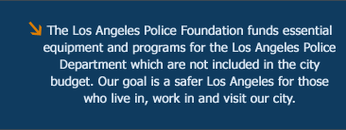
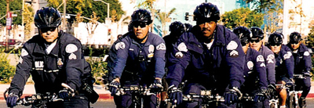
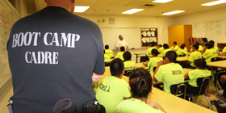
Los Angeles Police Foundation
With 96% of the LAPD’s budget spent on personnel, there is little left for major projects… Thanks to our supporters the Foundation has donated over $12 million to LAPD projects, programs and training that benefit our communities and help make our city a safer place to live, work and play.

Slide 17
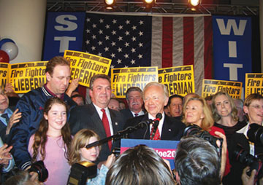
Political action
As fire fighters, you are leaders in your communities who serve the public during their time of need. However, you are also active within your community as civic leaders and activists. Because of this, you have a unique opportunity through political action to make a difference in the electoral process.
The IAFF can be a resource to locals and members beginning the process of becoming politically active or for those that are political veterans. FIREPAC also offers assistance to those members and/or member’s family who have decided to run for public office

Slide 18
In summary
UK ‘Service’ charities
USA equivalents
Origins: individual volunteers
Mission: employees & social/health care
Added Value: Public sector CSR
Funding: diverse -payroll giving & trading
Origins:Service-led
Mission: service improvements
Added Value: Private sector sponsorship
Funding: donations, sponsorship, Federal/State Government grants

Slide 19
Public Sector Cuts
Government cutbacks could wipe out 25 per cent of charities
One in four large charities could find themselves at a "financial cliff edge" next year when public sector cuts begin to bite, according to research published by the Charity Commission. Numerous service contracts between charities and public sector bodies will end in March 2011, with devastating effects for many charities, according to Dame Suzi Leather, the commission's chair. Research into more than 1,000 charities found that 59 per cent have now been affected by the economic downturn, compared to just 38 per cent in September 2008.
The Independent, 24th March 2010

Slide 20

Achieving sustainability in a changing public sector climate
Workforce cuts
Salaries frozen
Public support ?
Reorganisation & amalgamation
Service redesign
Innovative partnerships
Transforming enterprises

Slide 21
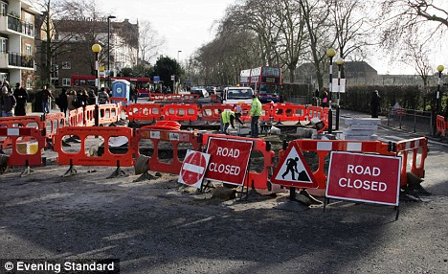
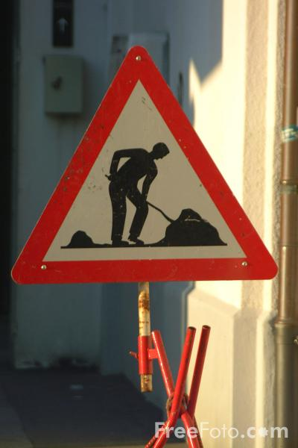
The end of the road or a new way of working?
Thank you

